Slide 1
Mobilize
Reduce time to achieve business outcomes and build the foundation for operational readiness

Slide 2
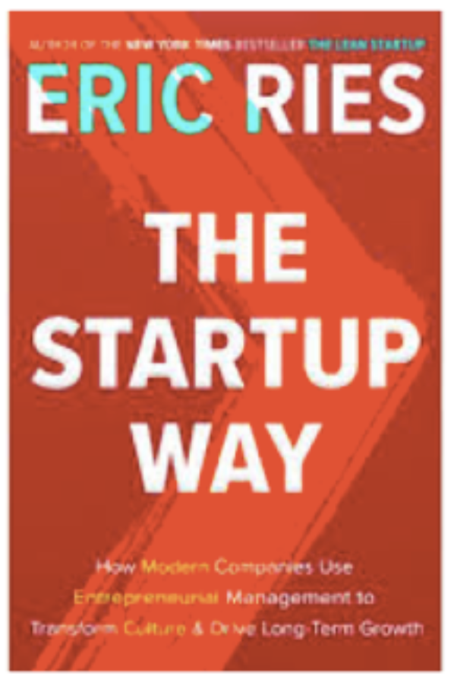

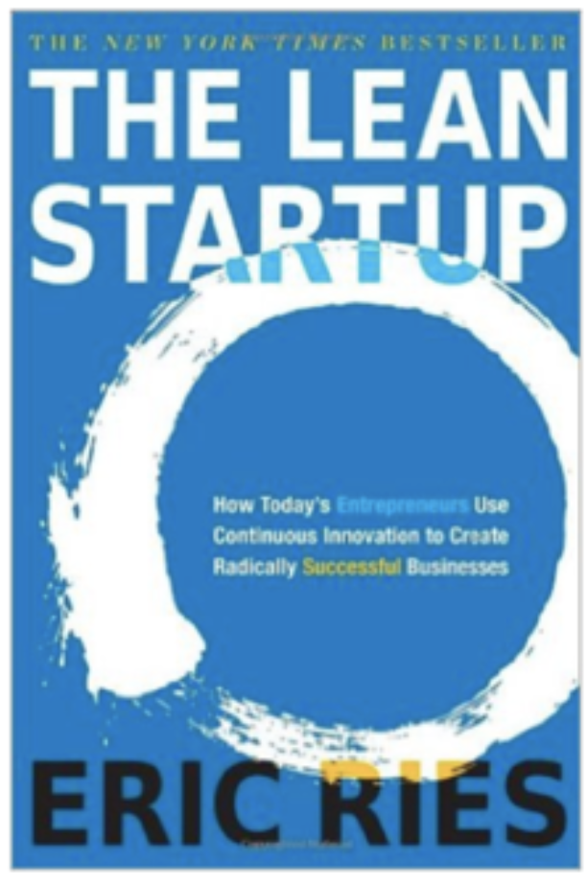
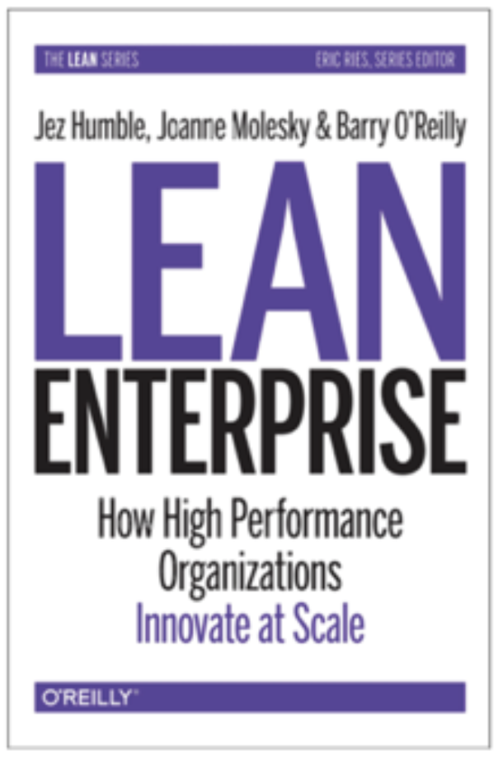


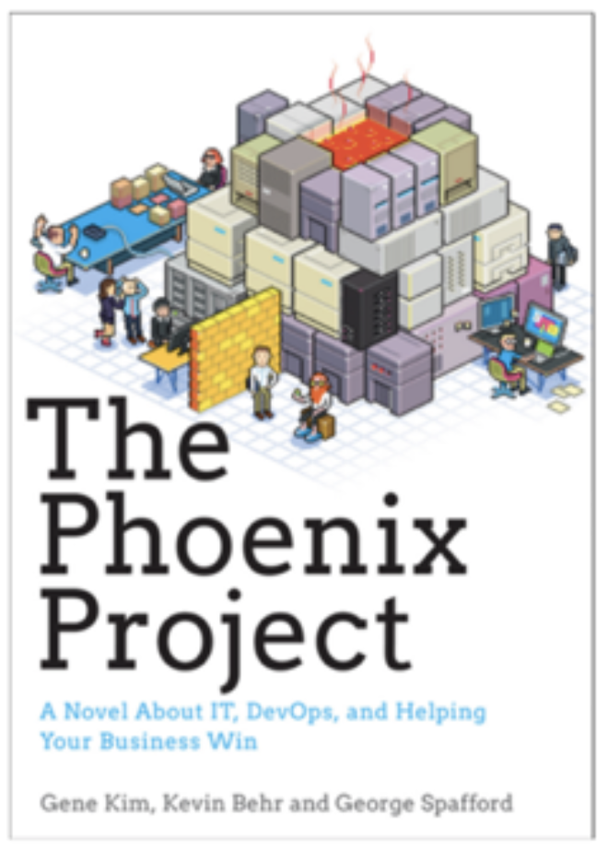
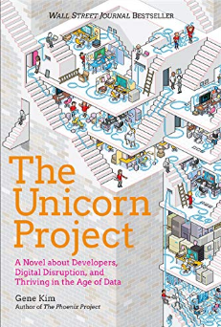

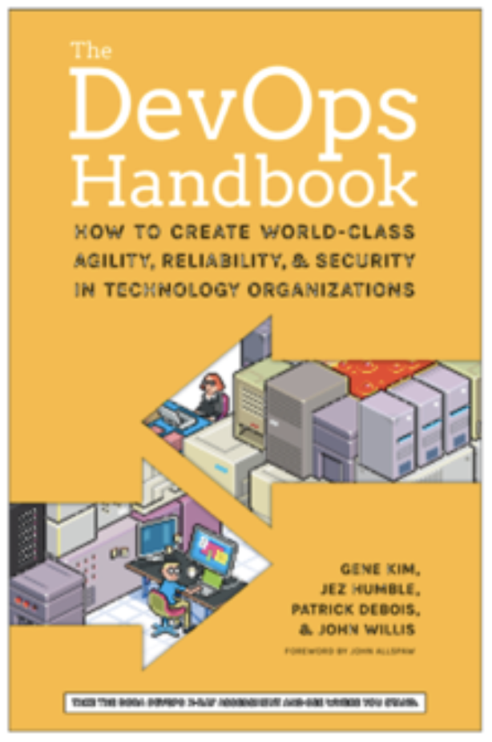
How do we organize for innovation?
Is it a one-way or a two-way door?
Two-Pizza teams are fast and agile, foster ownership and autonomy
Notes:
Mechanisms
Encoded behaviors that facilitate innovative thinking
Architecture
Structure that supports rapid growth and change
Culture
Customer obsession, hire builders, let them build, support them with a belief system
Organization
Small, empowered teams that own what they create

Slide 3
Mobilize: Readiness through experience
Mobilize
Establish and exercise an agile program to accelerate cloud operational readiness and cloud migrations.
At project close, the customer retains the Knowledge Base containing completed activities, decisions, and runbooks that support ongoing operations.
Set-up low-cost collaboration and governance mechanisms to manage cloud operations beyond Mobilize. (e.g. Agile Operations Workflow, IT Governance Decision Catalog, Video Library, Security Compliance Catalog, Application Migration Mechanisms)
Build the foundation that all other workstreams leverage to structure and prioritize work, collaborate and document knowledge, and report progress.
Establish stronger organizational change capability by engaging new ways of working (e.g. cross-functional collaboration, agile).
Notes:
Transformation
The Mobilize Phase helps customers establish and exercise an agile program to accelerate cloud operational readiness and cloud migrations. This engagement supports the set-up of low-cost collaboration and planning mechanisms that implement and automate many activities within the AWS Cloud Adoption Framework. These mechanisms optimize end-user experience for distributed teams and are foundational to execute readiness and migration initiatives. This engagement builds the foundation that all other workstreams leverage to structure and prioritize work, collaborate and document knowledge, and report progress.
The Mobilize Phase has the following objectives:
Ensure high visibility with Executive Sponsor.
Leverage agile methodologies, project control, business communication plan, and execute delivery of the migration plan.
Work with key stakeholders to assemble project teams, assign responsibilities, and develop schedules to ensure timely project completion, while minimizing risk to maximize customer success.

Slide 4
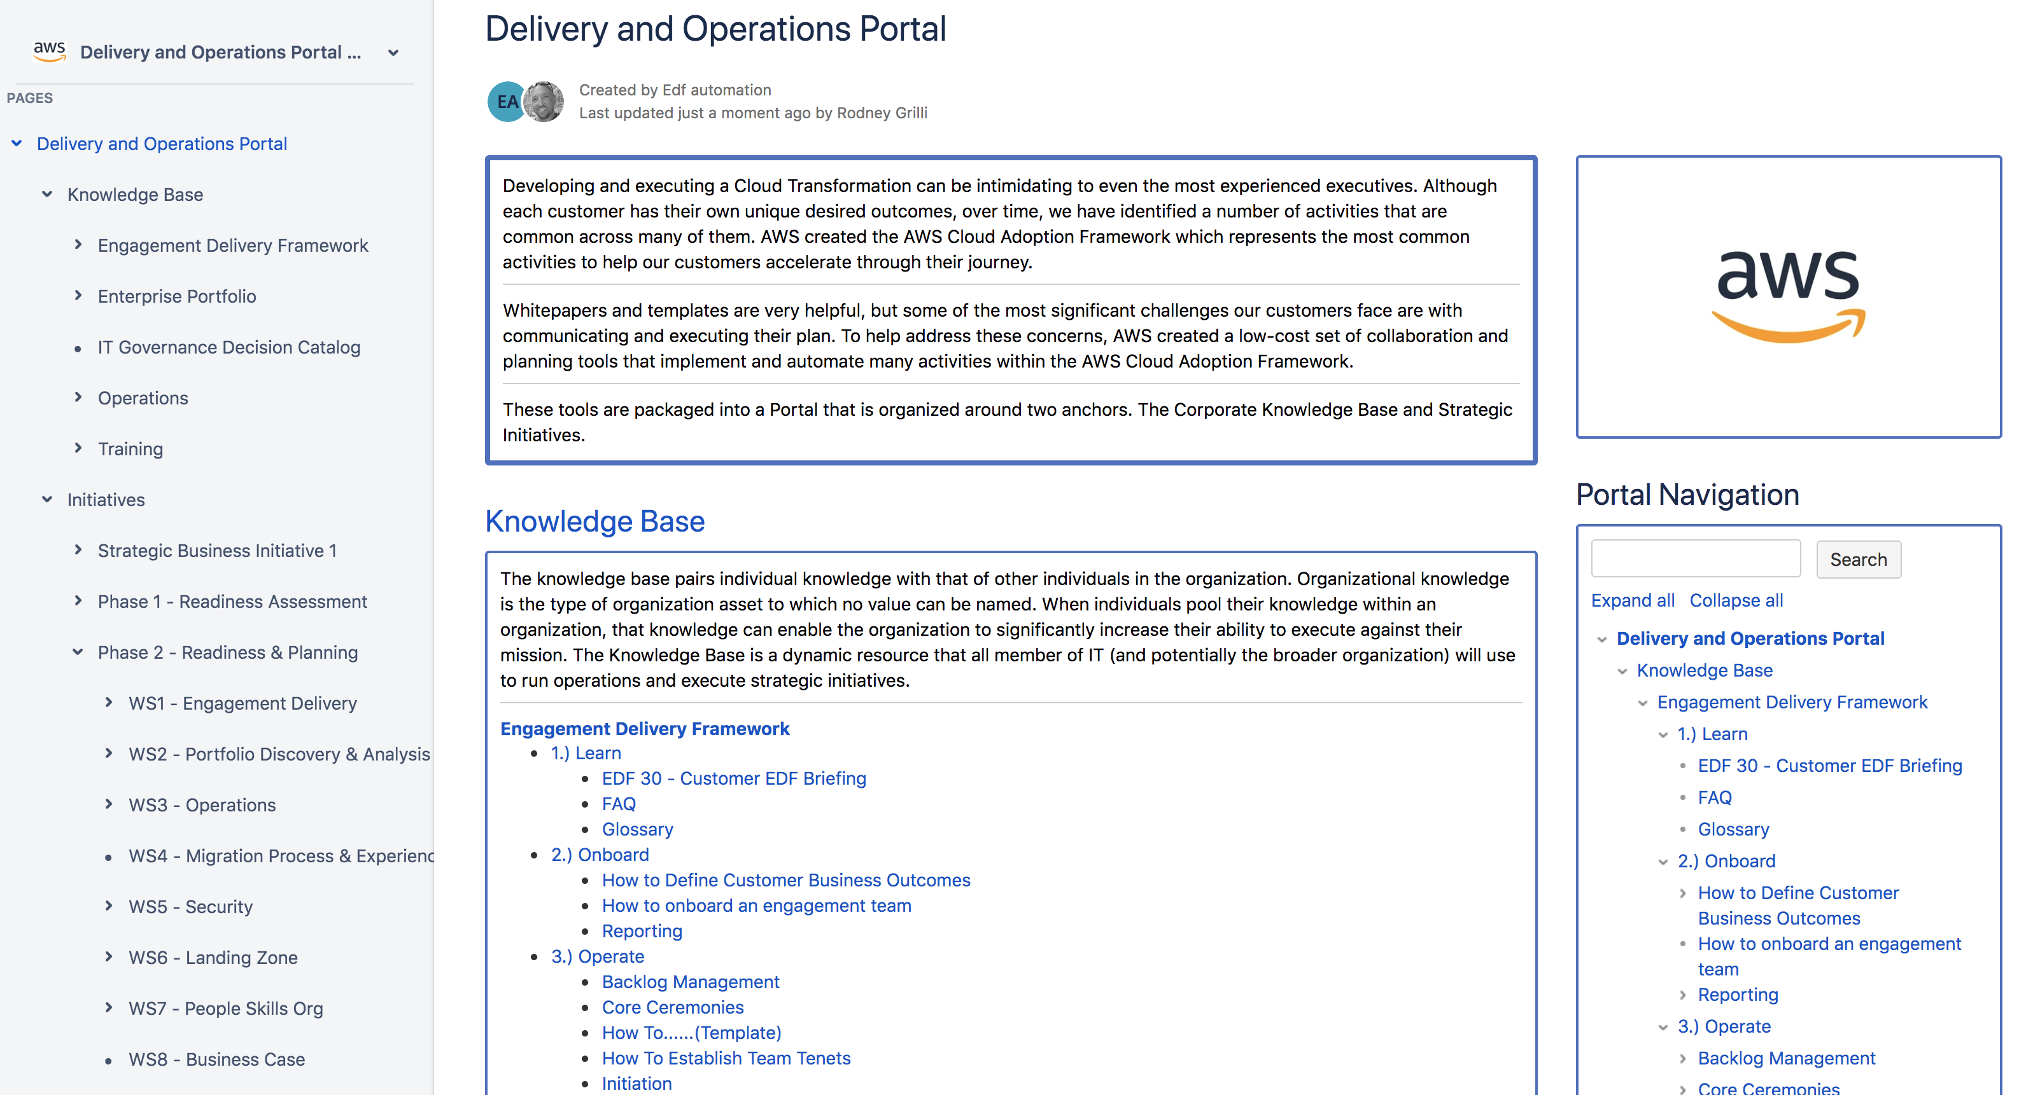
Delivery and Operations Portal
Mobilize Demo
The Knowledge Base is implemented as an online tool hosted in the customer’s environment. Delivery Kits are imported and artifacts are baselined throughout Mobilize.
At project close, the customer retains a Knowledge Base containing completed activities, decisions, and runbooks that support ongoing operations.
Notes:
The Mobilize offering is designed to optimize both remote delivery and ongoing operations for geographically distributed customer teams. The purpose of this Demo is to provide best practices for either in-person or remote delivery. Whitepapers and templates are very helpful, but some of the most significant challenges our customers face are with communicating and executing their readiness and migration initiatives. To help address these concerns, the Mobilize offering includes a low-cost set of collaboration and planning mechanisms that implement and automate many activities within the AWS Cloud Adoption Framework. These mechanisms optimize end user experience for large distributed teams.

Slide 5
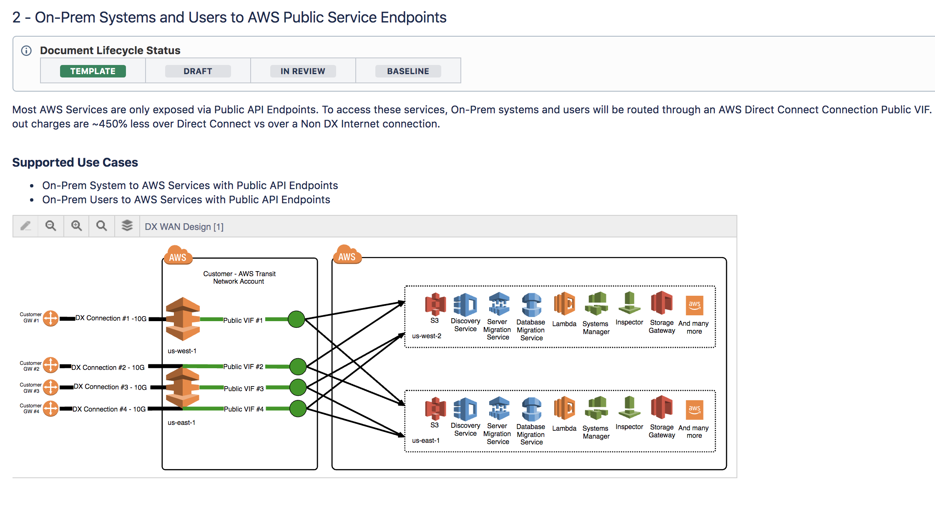
Technical Design Diagrams & Documentation
Mobilize Demo
Governance is built in to all documents and managed through weekly Sprint activities.
For example, once a document is “In Review” it’s shared at the weekly Sprint Demo. Then if the buyer accepts the artifact it’s moved into “Baseline”.
Design diagram templates are embedded within delivery kits using the Draw.io plug-in.
Notes:
Knowledge Management
The Knowledge Base is implemented as an online tool hosted in the customer’s environment and serves as the single repository for information regarding the customer’s cloud journey. The Knowledge Base pairs individual knowledge with that of other individuals in the organization. Organizational knowledge is the type of asset to which no value can be named. When individuals pool their knowledge within an organization, that knowledge can enable the organization to significantly increase their ability to execute against their mission.
Governance is built in to all documents within the Knowledge Base (see the Document Lifecycle Status at the top of each page). This is used in conjunction with the weekly Sprint activities. For example, once a document is “In Review” it’s shared at the weekly Sprint Demo. Then if the buyer accepts the artifact it’s moved into “Baseline”. Critical artifacts are sometimes provided to customer leadership through the IT Governance Decision Catalog for approval beyond baseline. Baselined documents are locked for editing in Confluence.

Slide 6
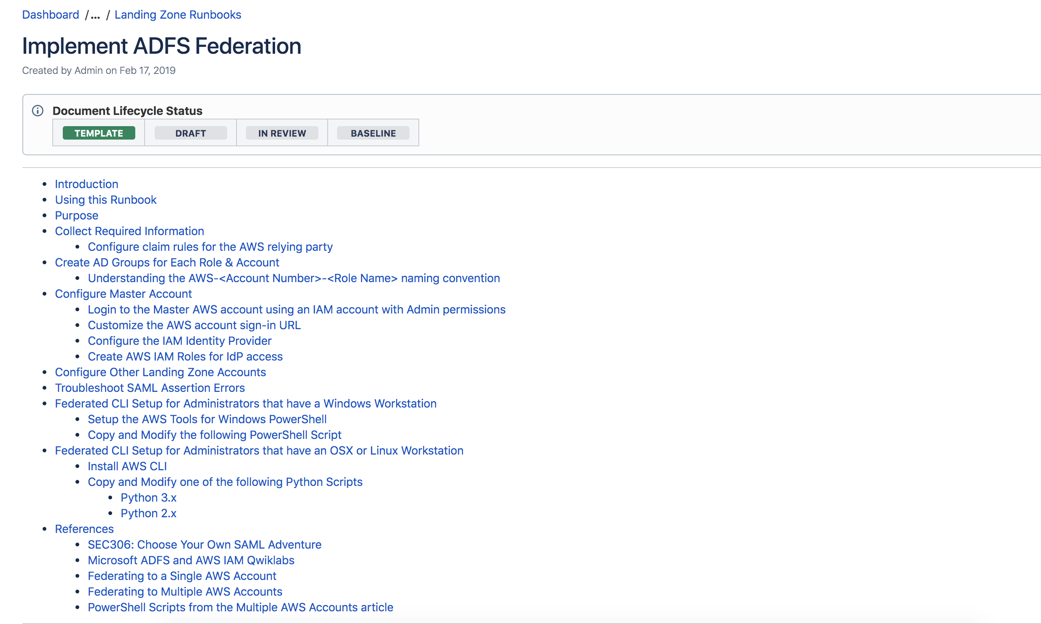
Operations Runbooks with Lifecycle Governance
Mobilize Demo
All technical and business artifacts developed and can be used to run operations, execute strategic initiatives, and serve as reference and training guidance for existing and new team members.
Notes:
The Knowledge Base is a dynamic resource that all members of IT (and potentially the broader organization) will use to run operations and execute strategic initiatives. The Knowledge Base serves as the single place to collaborate and bring a work product through a governance process to validate customer acceptance. The completed Knowledge Base is intended to be a self-service online library including any and all relevant operational Artifacts and Runbooks. At the completion of the Mobilize engagement, the Knowledge Base will encapsulate all technical and business artifacts developed and can be used as reference and training guidance for existing and new team members. Currently, the delivery kits that are used to seed the Knowledge Base are in Confluence format, and additional formats are targeted for future releases.

Slide 7
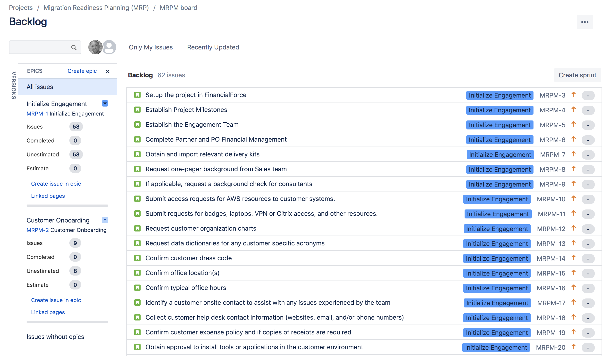
Readiness & Planning Backlogs
Mobilize Demo
No project plans are used. Instead, a template backlog is tailored to customer requirements. These backlogs are managed in an online tool to provide tracking against the Sprint Goals and offer full visibility to project teams and Executive Sponsorship even when geographically dispersed.
Notes:
Workflow & Activity Management
Delivery is based on agile principles and uses one week sprints to work through the backlog. No project plans are used. Instead, each workstream has a template backlog from which Consultants should tailor the activities specific for the customer. These backlogs are managed in an online tool to provide tracking against the Sprint Goals and offer full visibility to project teams and Executive Sponsorship even when geographically dispersed. Currently, the delivery kits that are used to seed the Backlog are in Jira format, and additional formats are targeted for future releases.

Slide 8
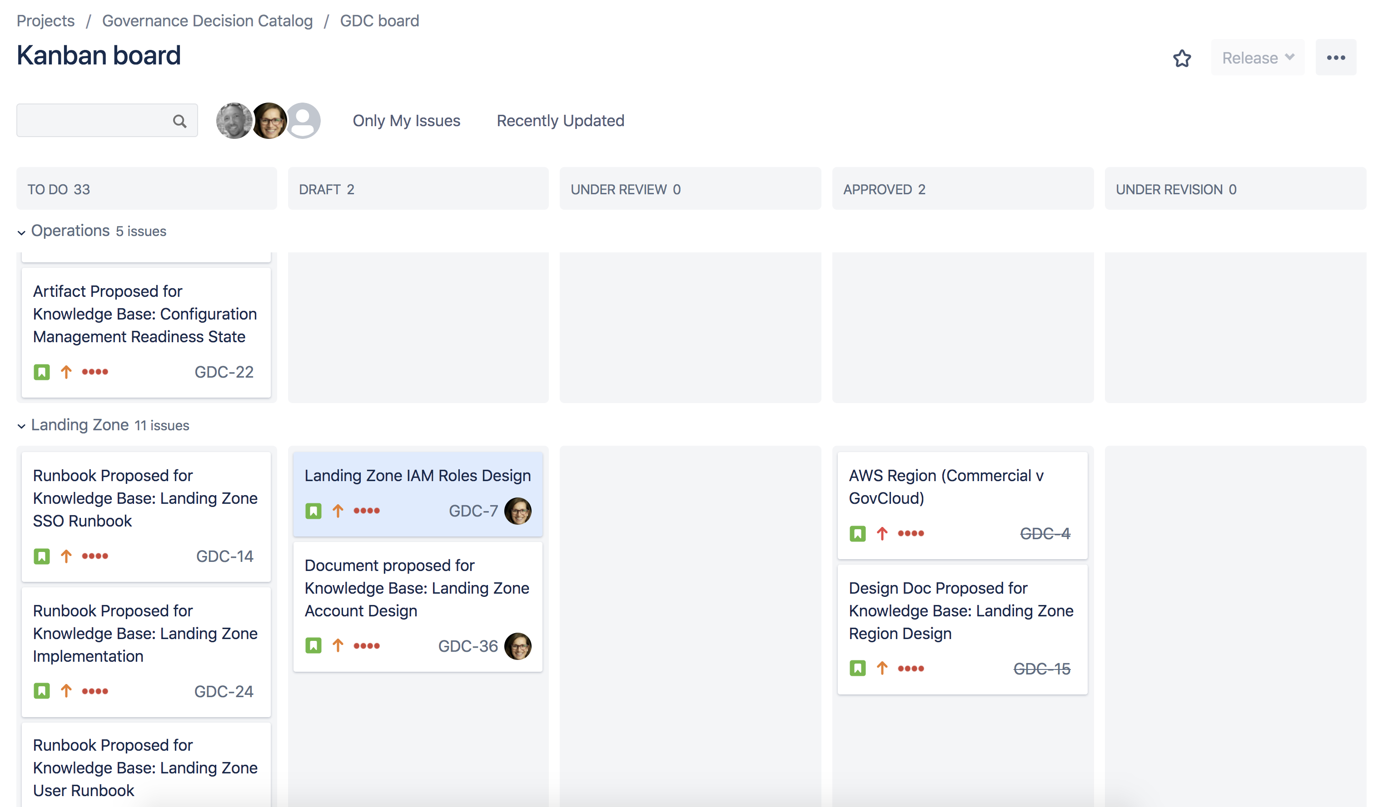
IT Governance Decision Catalog
Mobilize Demo
Hosted in the customer’s environment to serve as a centralized place to track the customer’s decisions throughout their cloud journey.
This mechanism helps facilitate the decision workflow and serves as a historical record. All stakeholders involved in the project have access to this catalog to be able to view final decisions and propose recommendations and/or request decisions.
The recommended workflow helps customers manage two-way door decisions and overcome blockers by requiring data and documentation to support decisions.
Notes:
IT Governance Decision Catalog
An IT Governance Decision Catalog is an online tool hosted in the customer’s environment to serve as a centralized place to track the customer’s decisions throughout their cloud journey. This mechanism helps facilitate the decision workflow and serves as a historical record. All stakeholders involved in the project have access to this catalog to be able to view final decisions and propose recommendations and/or request decisions. The recommended workflow helps customers manage two-way door decisions and overcome blockers by requiring data and documentation to support decisions.

Slide 9
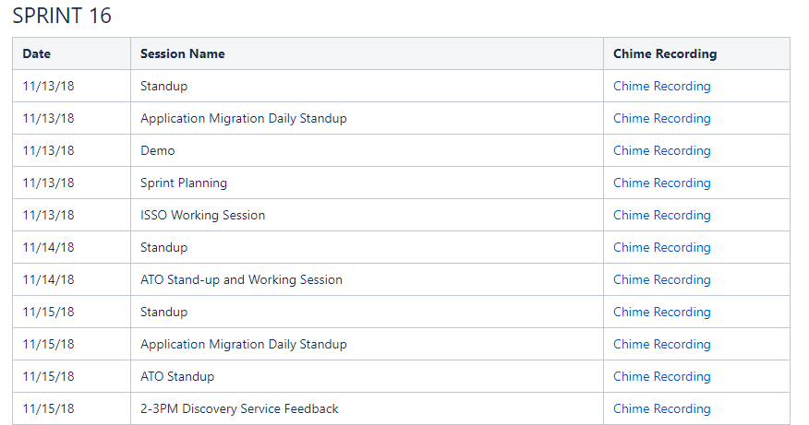
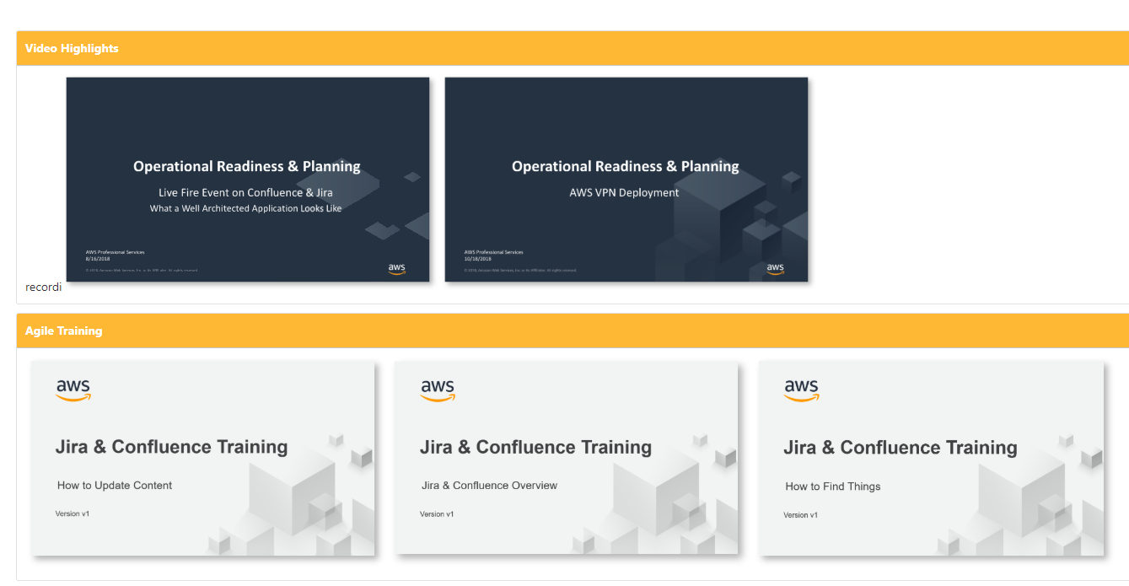
Video Library
Mobilize Demo
All sprint ceremonies and work stream sessions are recorded. Recordings capture screen sharing and audio, ensuring visibility and knowledge transfer for either existing or new team members. This mechanism removes engagement blockers because meetings can still be held, even without all stakeholders. Absent stakeholders can later watch the meeting and provide inputs asynchronously. Organizations are able to capture the evolution and details of an engagement such that future, new team members are able to view recordings to support training and awareness.
Notes:
Video Library
All sprint ceremonies and work stream sessions are recorded. Recordings capture screen sharing and audio, ensuring visibility and knowledge transfer for either existing or new team members. This mechanism removes engagement blockers because meetings can still be held, even without all stakeholders. Absent stakeholders can later watch the meeting and provide inputs asynchronously. Organizations are able to capture the evolution and details of an engagement such that future, new team members are able to view recordings to support training and awareness. The recording library supports a geographically dispersed workforce, as well as a remote workforce, that may need to watch meeting recordings after the fact due to competing priorities or timezone challenges. Given the current global situation with COVID-19 many workers are balancing work and caring for others, and the recording library supports improving the lives of these professionals.

Slide 10
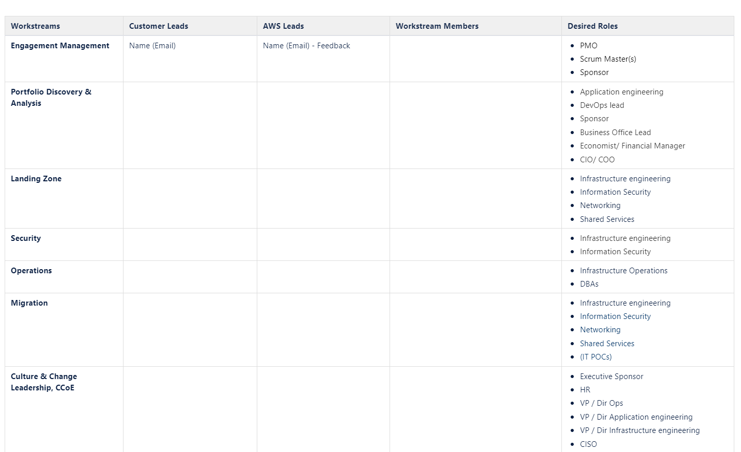
Workstream Leads and Members
Mobilize Demo
We work with the customer Executive Sponsor to identify the core team of customer staff that will be single-threaded leaders for each workstream and will be available full-time, 3-5 days per week, throughout the entire engagement.
Notes:
Pre-Planning with Customer Executive Sponsor
We work with the customer Executive Sponsor (typically at the CIO and Deputy CIO level) to identify the core team of customer staff that will be single-threaded leaders for each workstream and will be available full-time at least 3-5 days per week throughout the entire engagement. For onsite delivery, AWS Consultants are typically onsite Tues-Thurs, but in a remote delivery this timeline and the specific days are more flexible since no travel time is needed.

Slide 11
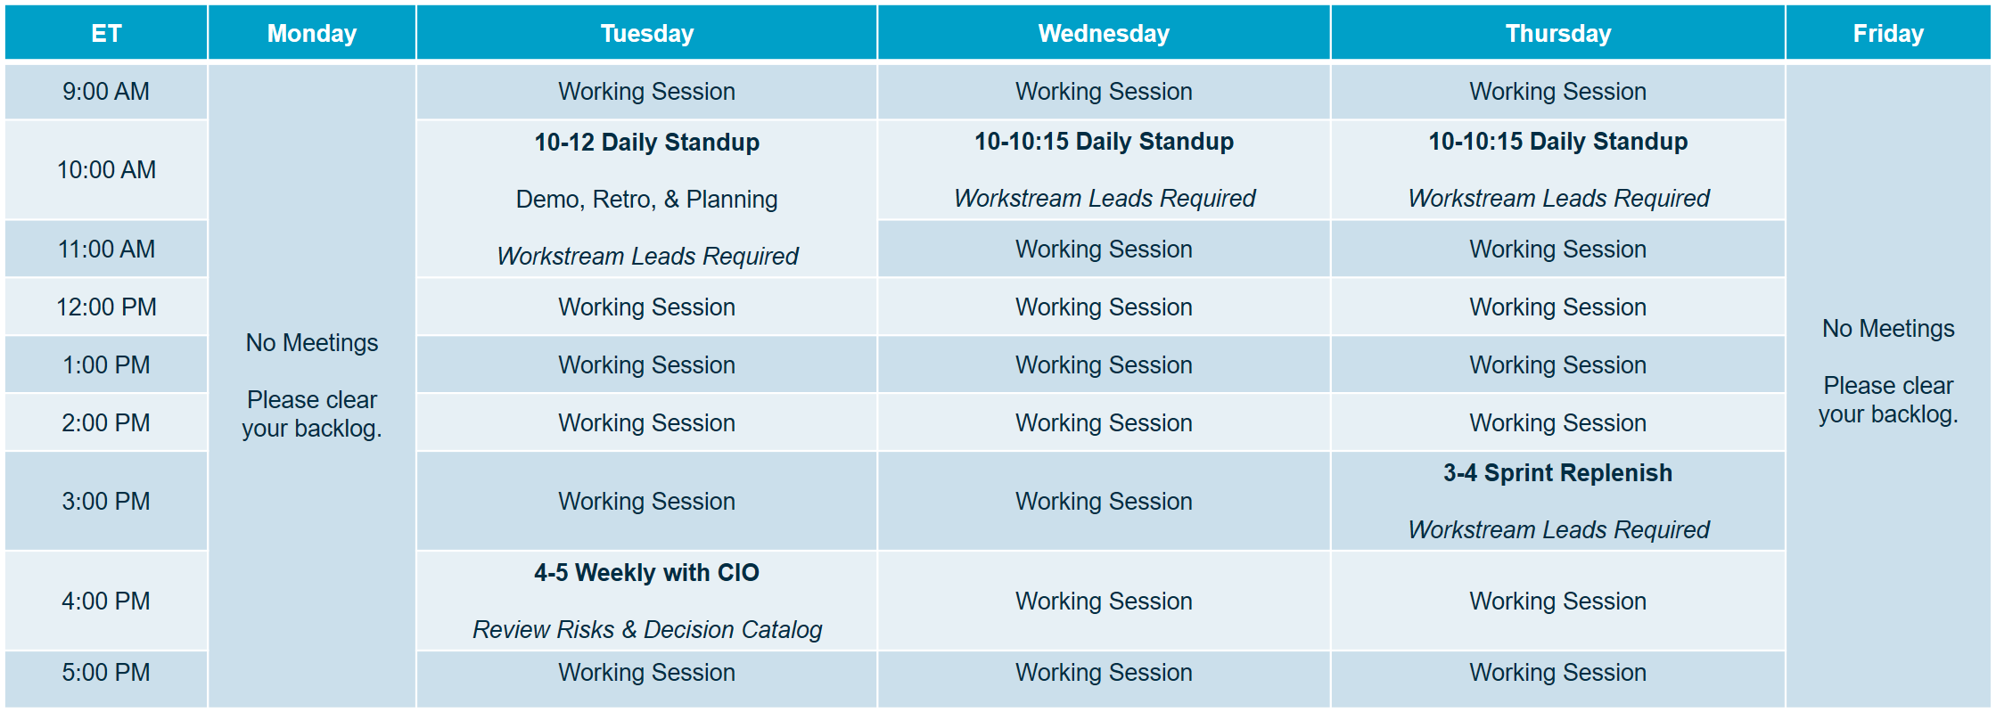
Agile & Weekly Sprints
Mobilize Demo
Mobilize occurs in one week sprints, where the sprint cycle starts/ends mid-week. Online tools are used for all sprint ceremonies which are executed via remote collaboration tools that allow for participant video, screen sharing, and session recording.
Notes:
Sprint Cadence
One week sprints are recommended, where the sprint cycle starts/ends mid-week with supporting sprint ceremonies (demo, retrospective, sprint planning). A daily stand-up is also held each day to ensure progress, communication, and to clear any blockers. Each week, a Customer Executive Sponsor meeting is held to disposition decisions in the IT Governance Decision Catalog, review the Risk Register and help clear any blockers. Online tools are used for all sprint ceremonies which are executed via remote collaboration tools that allow for participant video, screen sharing, and session recording. With a remote workforce, Governance through this cadence and online systems becomes even more critical. Through these mechanisms the Mobilize Product enables Governance that is inherently built-in to everyday work activities.

Slide 12
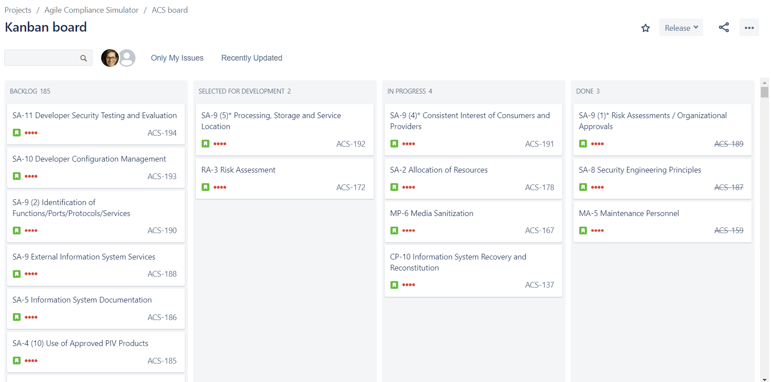
Agile Compliance Board
Mobilize Demo
Small, agile teams focused on security compliance. Security controls and justifications are tracked as tickets in weekly sprint cycles.

Slide 13
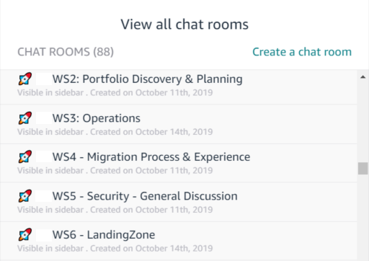
Persistent Chat & No Email
Mobilize Demo
Ground Rules and Team Norms are established with the Customer Executive Sponsor.
No Email Best Practice
All communications are conducted via persistent chat rooms/channels
All documents are managed within the Knowledge Base
All actions/activities are managed within the backlog tooling
All decisions are managed within the IT Governance Decision Catalog
Notes:
Persistent Chat
Persistent chat rooms for each workstream where team members can collaborate real-time and this serves as a historical record for others to get caught up. This works well for consultants that are running workstreams because they have more open lines of communication with the customer team. These rooms help keep stakeholders focused on completing their activities and allows for updates throughout the day to unblock others.
No Email Rule
All communications are conducted via persistent chat rooms/channels
All documents are managed within the knowledge base
All actions/activities are managed within the backlog tooling
All decisions are managed within the IT Governance Decision Catalog

Slide 14
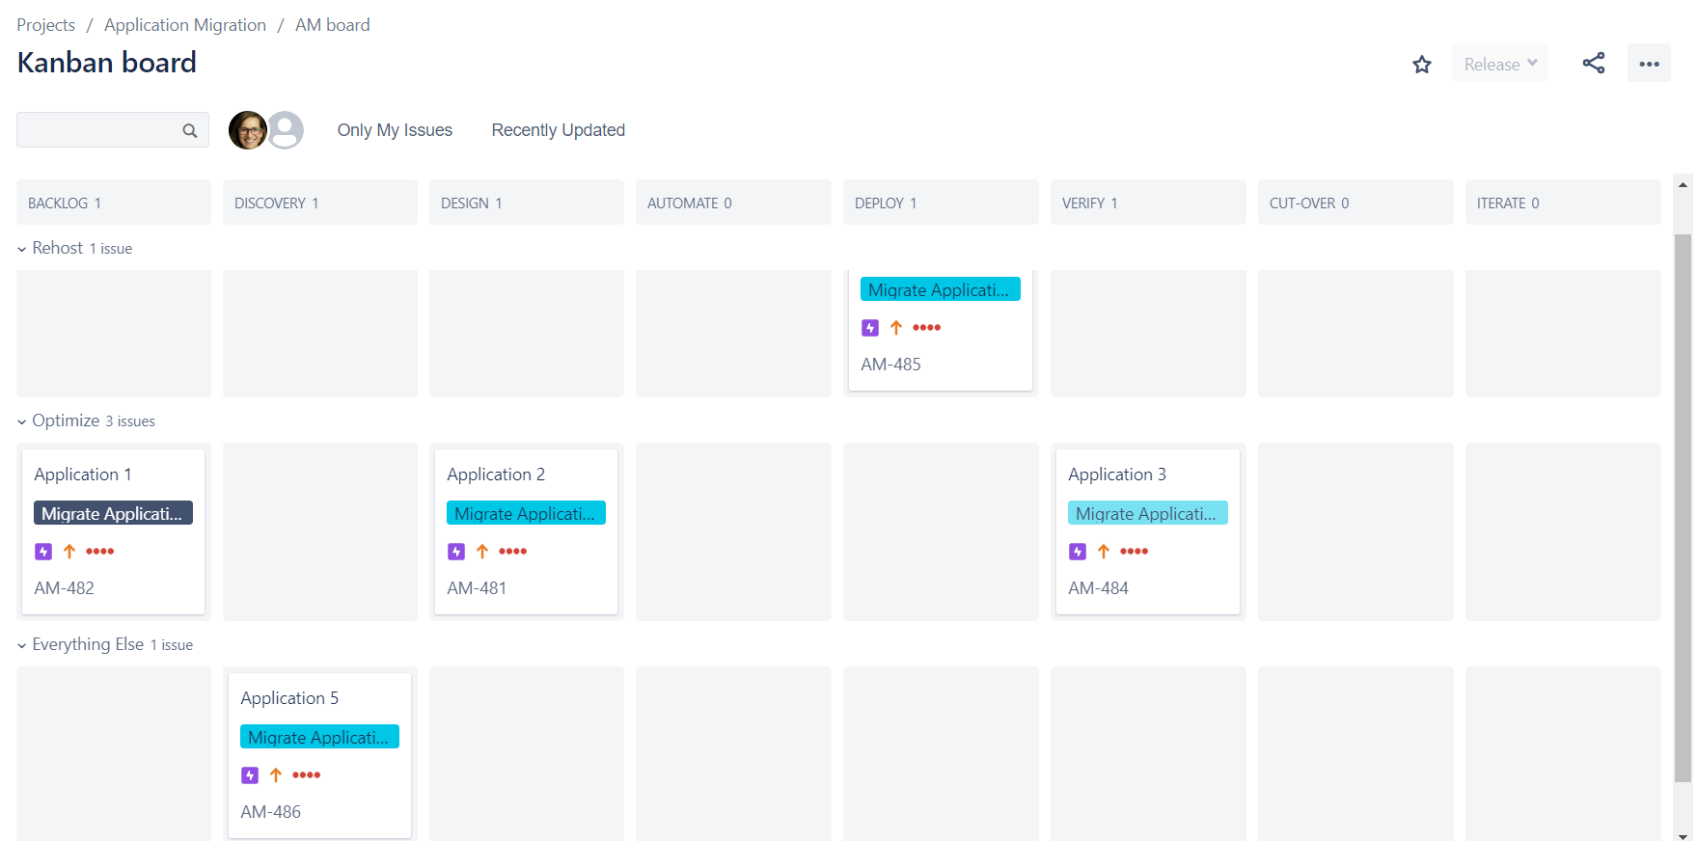
Application Migration Board
Mobilize Demo
Mobilize pilots will establish mechanisms to manage, track, and report migrations. These methods are sustainable beyond the Mobilize engagement.

Slide 15
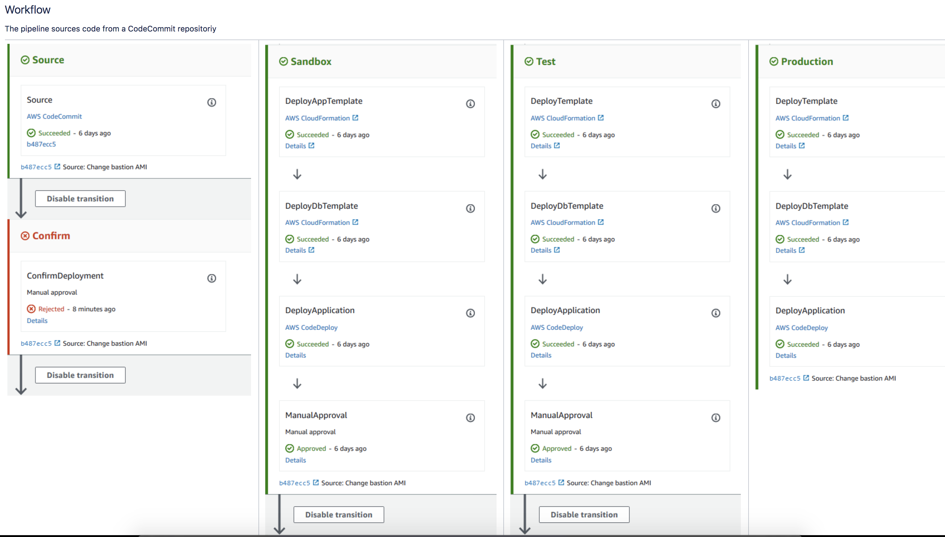
Fully Automated CI/CD Product Pipelines
Mobilize Demo

Slide 16
Customer Commitments Required
Executive Sponsorship Identify Executive Sponsorship (C-Level). Establish weekly cadence with Executive Sponsor to unblock issues, expedite processes, and make decisions.
Customer Team
Identify customer staff to be available full-time, 3-5 days per week, for the duration of the engagement. Assign single-threaded leaders to drive work stream teams using “two-in-the-box” approach with AWS consultants.
Agile Methodology & Tools Customer to put in place, or extend, engagement tools that support an agile methodology and provide communication and tracking to implement proper governance: Jira, Confluence with Draw.io plugin, Persistent chat, Remote collaboration that provides screen share and recording capabilities.
Mobilize
Notes:
PRIMARY MESSAGE: We know enterprise migrations can be challenging. It is a disruptive process for your business and IT organization specifically. You must deal with some complex challenges; including, deconstructing and understanding the on-premise technical environment, changing your operational processes, and helping your organization through cultural change – among other issues. In response, we developed best practice guidance based on our experience successfully migrating hundreds of enterprises. As a leadership team, you must demonstrate clear conviction to move to the cloud – not just with sponsors but with senior management leaders in all organizations across the business. You must set, measure, and assign responsibility for clear business goals for your entire organization.
We work with customers in advance of an engagement to discuss and establish success factors for the Mobilize phase. Ideally, this is a conversation that begins pre-sales prior to a Statement of Work (SOW) and the details are finalized prior to the engagement kick-off.
Agile Methodology & Delivery method is based on agile principles and uses one week sprints. The artifacts created during this engagement move through a governance process to Executive Sponsorship for approval and submission to the IT Governance Decision Catalog and Knowledge Base, ensuring customer acceptance of deliverables.

Slide 17
Thank you!

